Slide 1
Difference between Backpropagation in CNN, RNN and ANN Manvith(nnm23is094) | Mohammad shaz (nnm23is100)

Slide 2
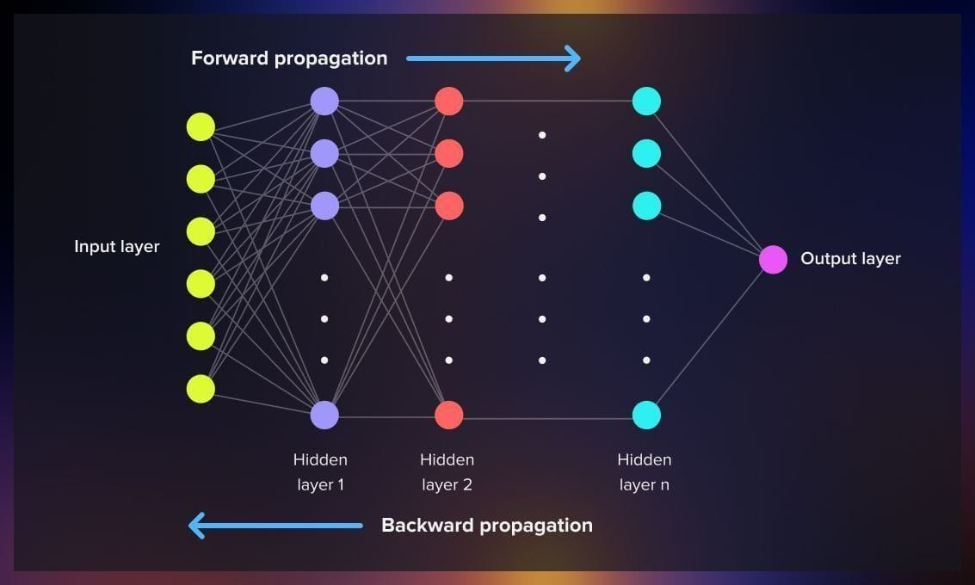
Backpropagation in Artificial Neural Networks (ANN)
Concept
Backpropagation in ANN computes the gradient of the loss function with respect to weights using the chain rule, and updates weights using gradient descent.

Slide 3

Forward Pass Formula:
For neuron $j$:
$$z_{j}=\sum_{i}{w_{ij}}x_{i}+b_{j}$$
$$a_{j}=f\left(z_{j}\right)$$
where
$x_{i}$= input
$w_{ij}$= weight
$b_{j}$= bias
$f$= activation function
Loss Function:
Example (Mean Squared Error):
$$L=\frac{1}{2}\left(y−\hat{y}{\left.)\right.}^{2}\right.$$

Slide 4
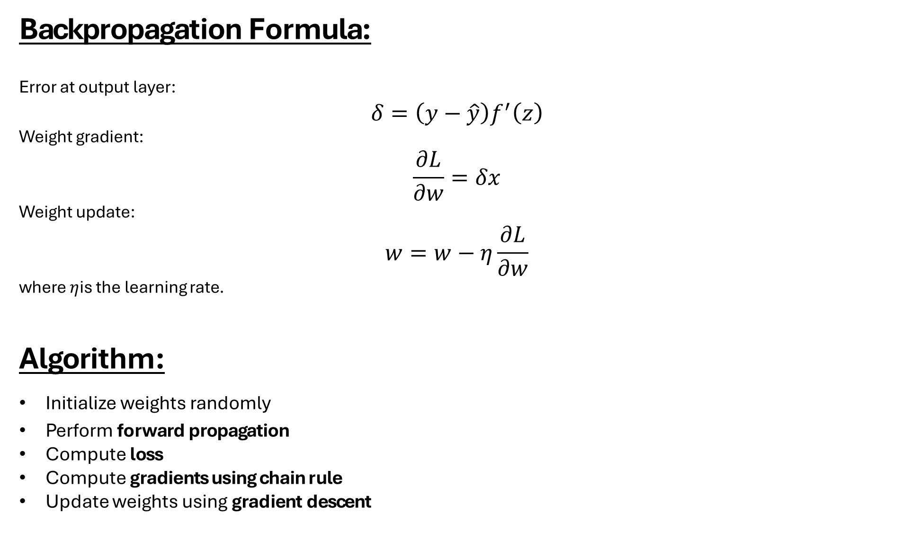
Backpropagation Formula:
Error at output layer:
$$δ=\left(y−\hat{y}\right)f^{′}\left(z\right)$$
Weight gradient:
$$\frac{∂L}{∂w}=δx$$
Weight update:
$$w=w−η\frac{∂L}{∂w}$$
where $η$is the learning rate.
Algorithm:
Initialize weights randomly
Perform forward propagation
Compute loss
Compute gradients using chain rule
Update weights using gradient descent

Slide 5
Running Example Code (ANN)
import numpy as np
# Input and target
X = np.array([[1, 2]])
y = np.array([[1]])
# Initialize weights
W1 = np.random.rand(2, 2)
W2 = np.random.rand(2, 1)
lr = 0.1
# Forward pass
h = np.dot(X, W1)
h_act = 1/(1+np.exp(-h)) # sigmoid
output = np.dot(h_act, W2)
y_pred = 1/(1+np.exp(-output))
# Loss
loss = np.mean((y - y_pred)**2)
# Backpropagation
d_output = (y_pred - y) * y_pred * (1 - y_pred)
dW2 = np.dot(h_act.T, d_output)
d_hidden = np.dot(d_output, W2.T) * h_act * (1 - h_act)
dW1 = np.dot(X.T, d_hidden)
# Weight update
W2 -= lr * dW2
W1 -= lr * dW1
print("Prediction:", y_pred)
print("Loss:", loss)

Slide 6
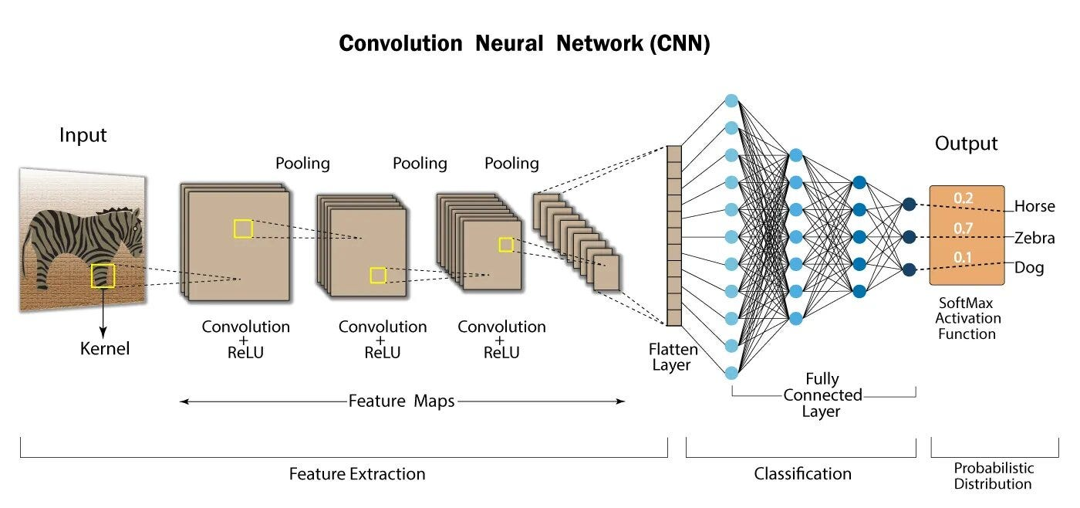
Backpropagation in Convolutional Neural Networks (CNN)

Slide 7
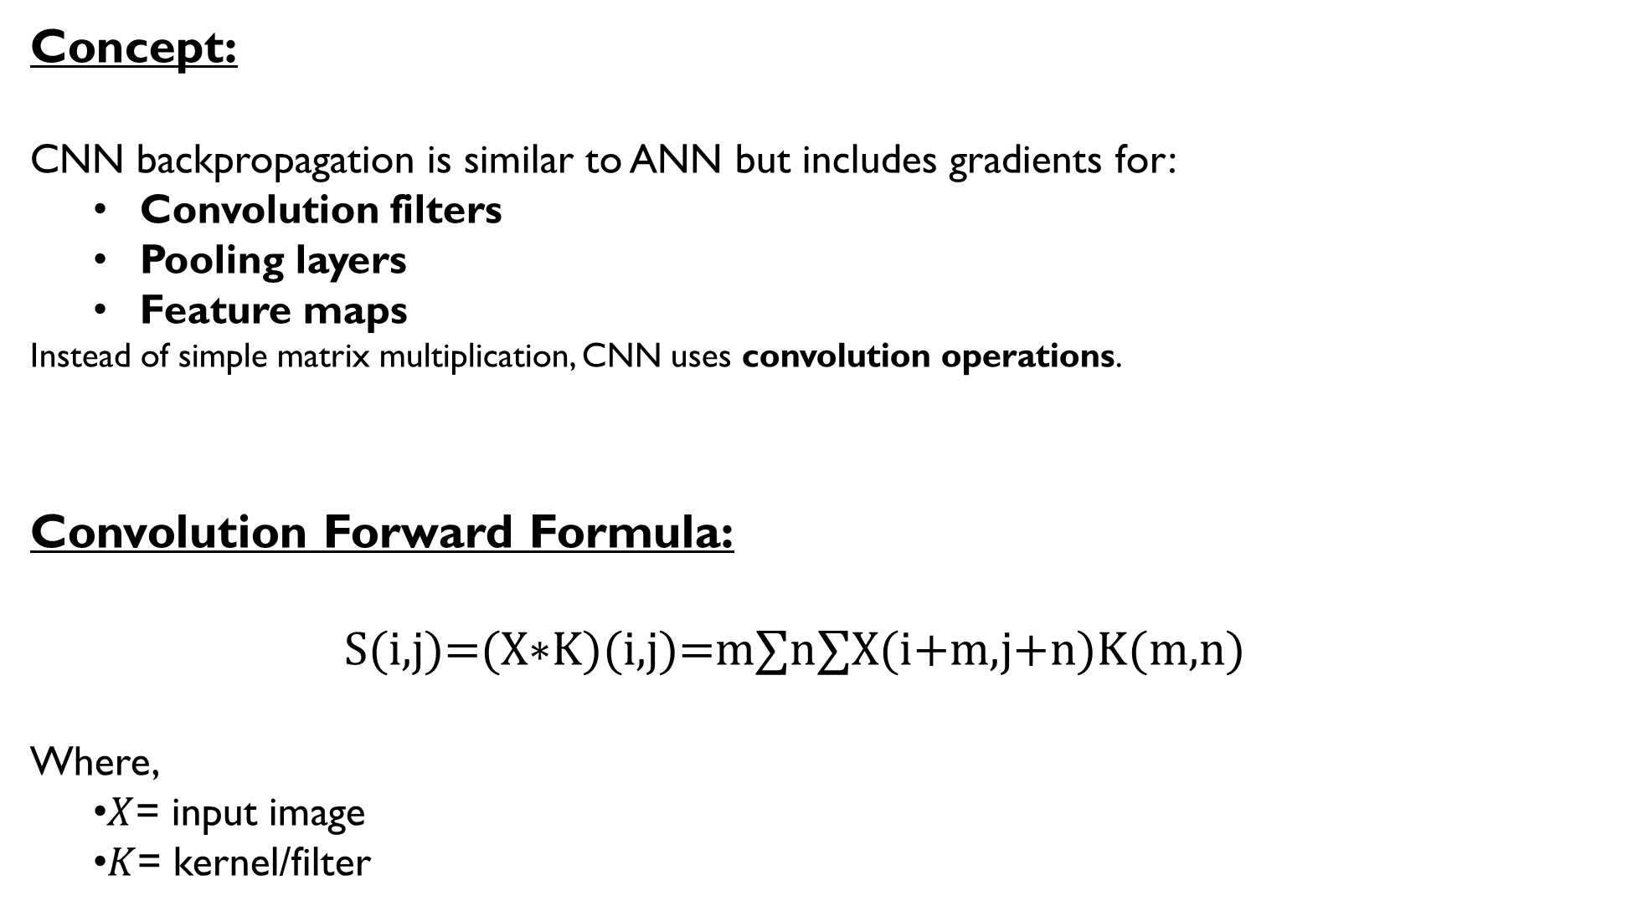
Concept:
CNN backpropagation is similar to ANN but includes gradients for:
Convolution filters
Pooling layers
Feature maps
Instead of simple matrix multiplication, CNN uses convolution operations.
Convolution Forward Formula:
S(i,j)=(X∗K)(i,j)=m∑​n∑​X(i+m,j+n)K(m,n)
Where,
$X$= input image
$K$= kernel/filter

Slide 8
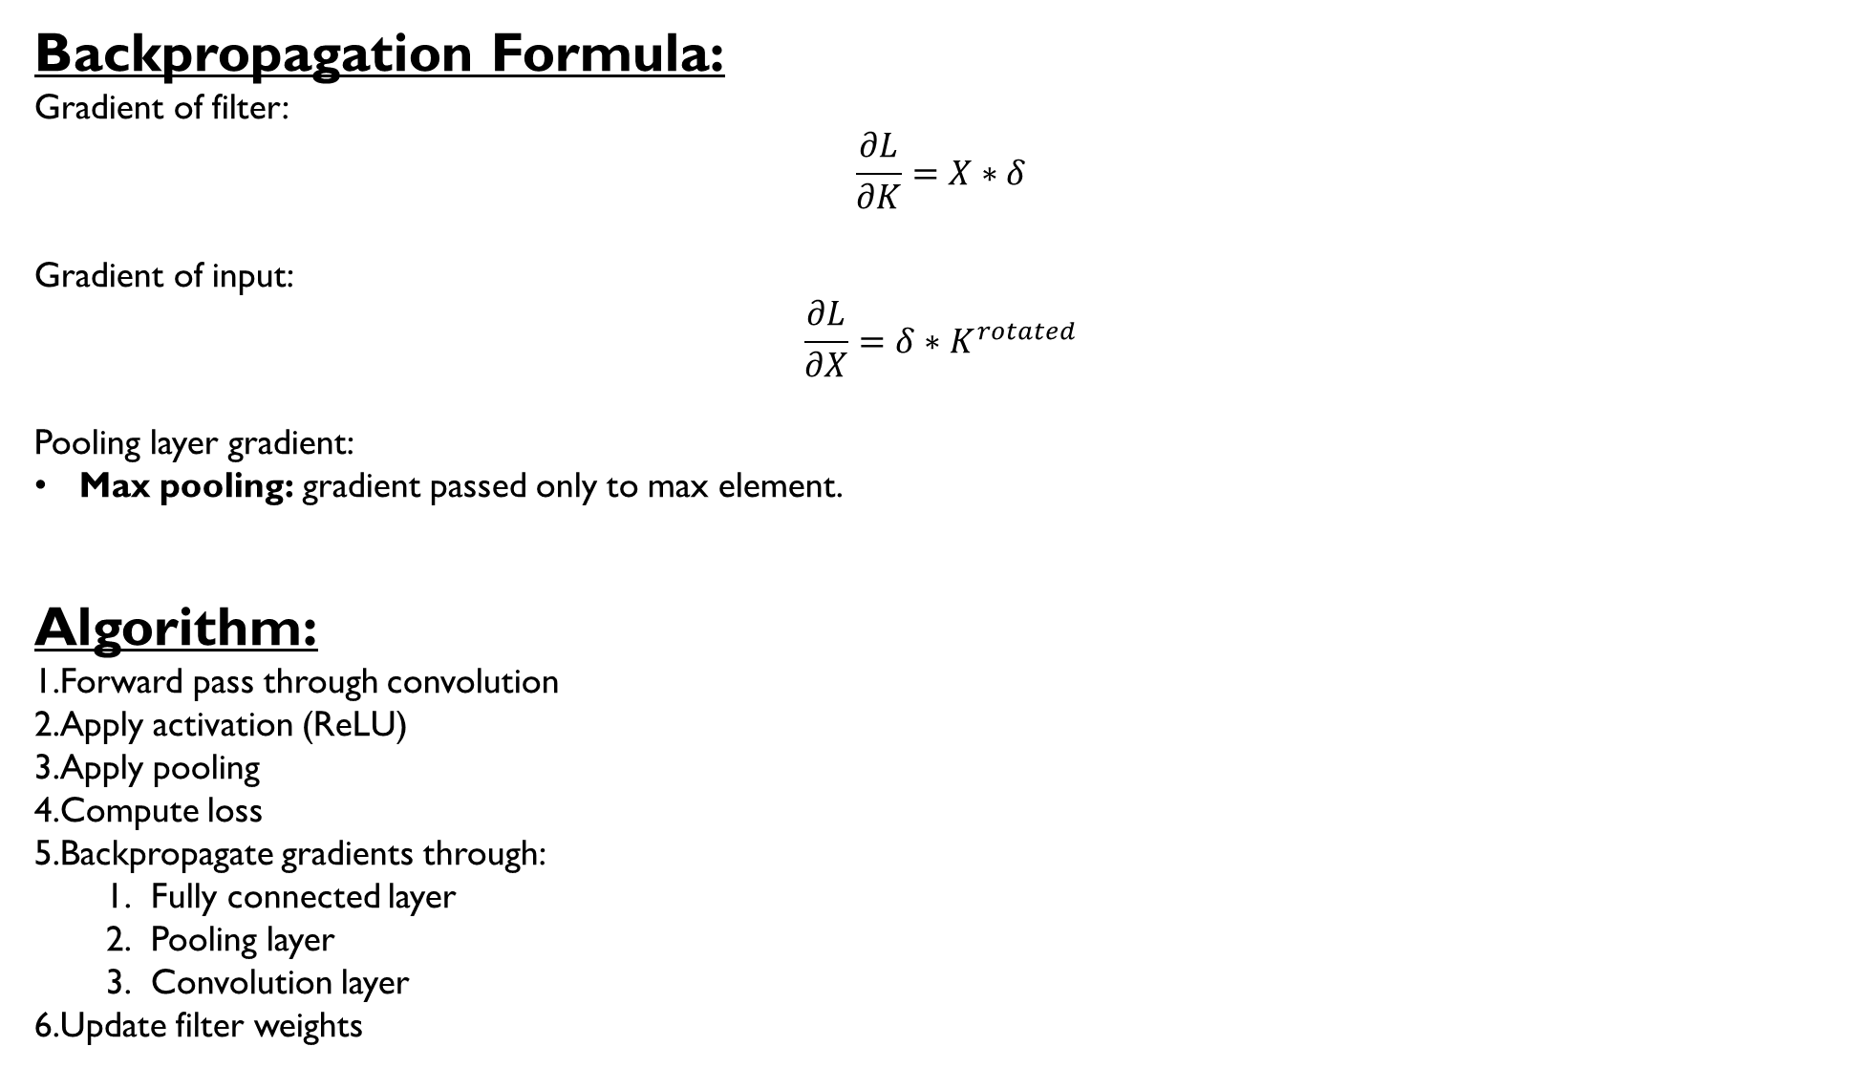
Backpropagation Formula:
Gradient of filter:
$$\frac{∂L}{∂K}=X∗δ$$
Gradient of input:
$$\frac{∂L}{∂X}=δ∗K^{rotated}$$
Pooling layer gradient:
Max pooling: gradient passed only to max element.
Algorithm:
Forward pass through convolution
Apply activation (ReLU)
Apply pooling
Compute loss
Backpropagate gradients through:
Fully connected layer
Pooling layer
Convolution layer
Update filter weights

Slide 9
Running Example Code (CNN)
import torch
import torch.nn as nn
import torch.optim as optim
# Simple CNN
class CNN(nn.Module):
def __init__(self):
super().__init__()
self.conv = nn.Conv2d(1, 1, kernel_size=3)
self.fc = nn.Linear(26*26, 1)
def forward(self, x):
x = torch.relu(self.conv(x))
x = x.view(-1, 26*26)
x = torch.sigmoid(self.fc(x))
return x
model = CNN()
# Dummy image
x = torch.randn(1,1,28,28)
y = torch.tensor([[1.0]])
criterion = nn.MSELoss()
optimizer = optim.SGD(model.parameters(), lr=0.01)
# Forward pass
output = model(x)
loss = criterion(output, y)
# Backpropagation
optimizer.zero_grad()
loss.backward()
optimizer.step()
print("Loss:", loss.item())

Slide 10
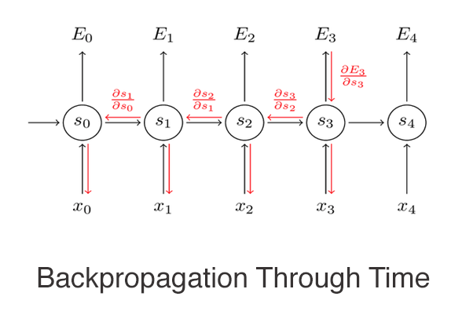
Backpropagation in Recurrent Neural Networks (RNN)

Slide 11
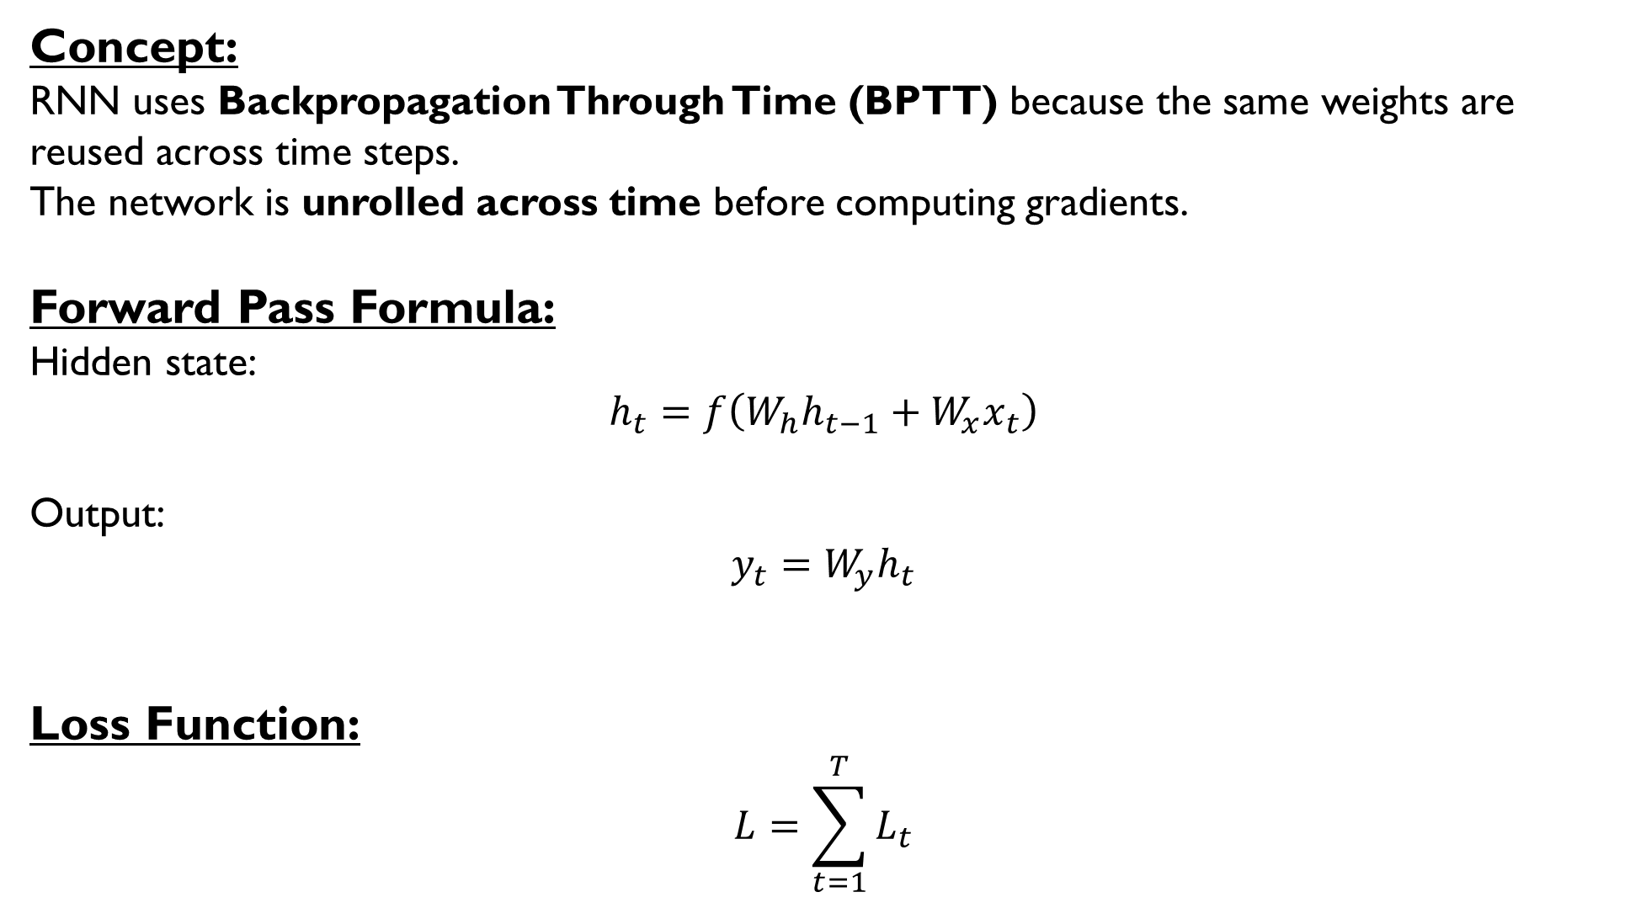
Concept:
RNN uses Backpropagation Through Time (BPTT) because the same weights are reused across time steps.
The network is unrolled across time before computing gradients.
Forward Pass Formula:
Hidden state:
$$h_{t}=f\left(W_{h}h_{t−1}+W_{x}x_{t}\right)$$
Output:
$$y_{t}=W_{y}h_{t}$$
Loss Function:
$$L=\sum_{t=1}^{T}{L_{t}}$$

Slide 12
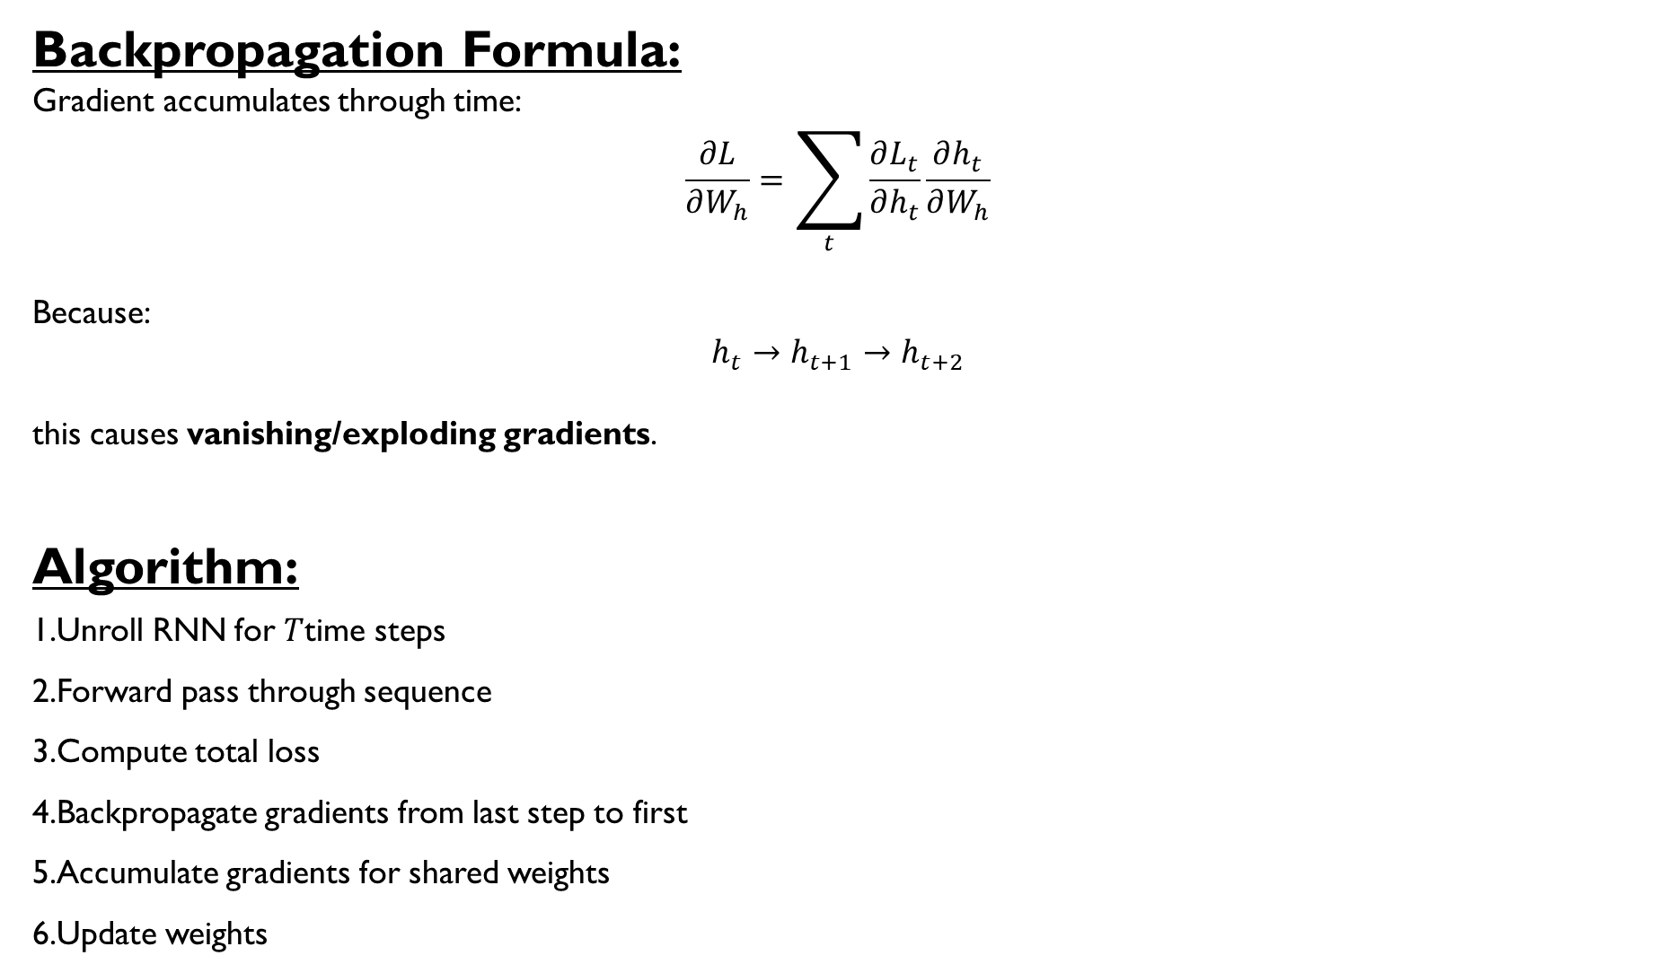
Backpropagation Formula:
Gradient accumulates through time:
$$\frac{∂L}{∂W_{h}}=\sum_{t}{\frac{∂L_{t}}{∂h_{t}}}\frac{∂h_{t}}{∂W_{h}}$$
Because:
$$h_{t}→h_{t+1}→h_{t+2}$$
this causes vanishing/exploding gradients.
Algorithm:
Unroll RNN for $T$time steps
Forward pass through sequence
Compute total loss
Backpropagate gradients from last step to first
Accumulate gradients for shared weights
Update weights

Slide 13
Running Example Code (CNN)
import torch
import torch.nn as nn
import torch.optim as optim
# Simple RNN
class RNNModel(nn.Module):
def __init__(self):
super().__init__()
self.rnn = nn.RNN(input_size=3, hidden_size=5, batch_first=True)
self.fc = nn.Linear(5,1)
def forward(self, x):
out, _ = self.rnn(x)
out = self.fc(out[:,-1,:])
return torch.sigmoid(out)
model = RNNModel()
# Dummy sequence (3 timesteps)
x = torch.randn(1,3,3)
y = torch.tensor([[1.0]])
criterion = nn.MSELoss()
optimizer = optim.Adam(model.parameters(), lr=0.01)
# Forward pass
output = model(x)
loss = criterion(output, y)
# Backpropagation Through Time
optimizer.zero_grad()
loss.backward()
optimizer.step()
print("Loss:", loss.item())

